Slide 1
Importing a VDI file in VirtualBox
CSC 4760 / 6760 Big Data Programming
Spring 2018

Slide 2
Download the VDI file
The VDI file (3GB) has been uploaded to iCollege and Google Drive. In this VM image, Java, Hadoop, and Eclipse are already set up.
iCollege only allows uploading maximum 1GB file. Thus I split the zip file (3GB) into 3 files. You can download them and join them into a single zip file by using the online tool: http://pinetools.com/join-files
After you download the "UbuntuVM.zip" file, unzip it.
I also upload the single "UbuntuVM.zip" file into Google Drive. You can also download it through the following link:
https://drive.google.com/file/d/1IBimMJCB-KZ_lfSUkodIASWjv04qogiD/view?usp=sharing
The password for user "rob" is 1234

Slide 3
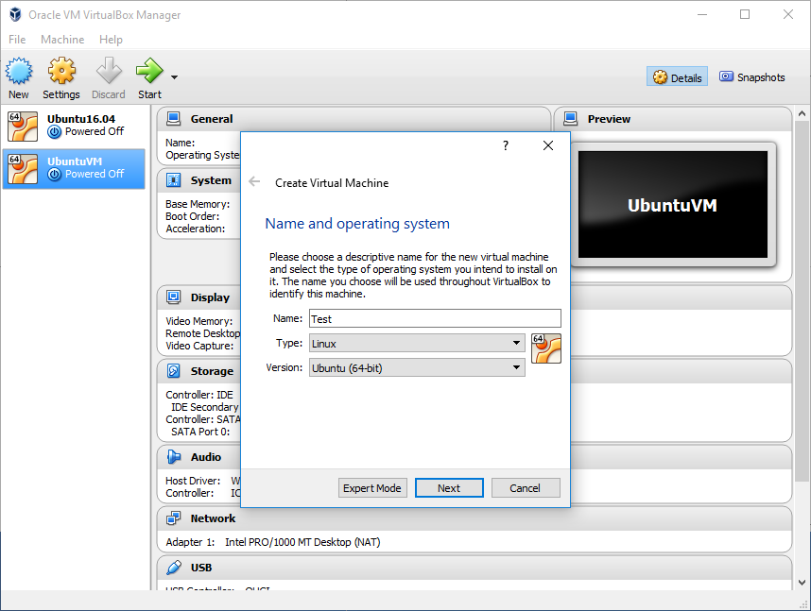
Step 1
Click “New”
Name: Test
Type: Linux
Version: Ubuntu (64-bit)
Click “Next”

Slide 4

Step 2
Memory size
Default 1GB is fine
Click “Next”

Slide 5
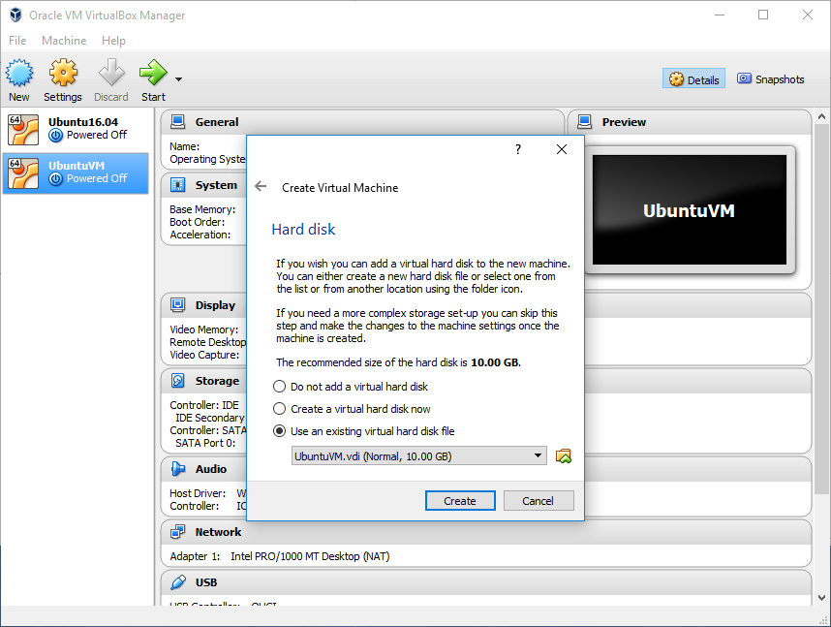
Step 3
Click “Use an existing virtual hard disk file”
Click “ ”

Slide 6
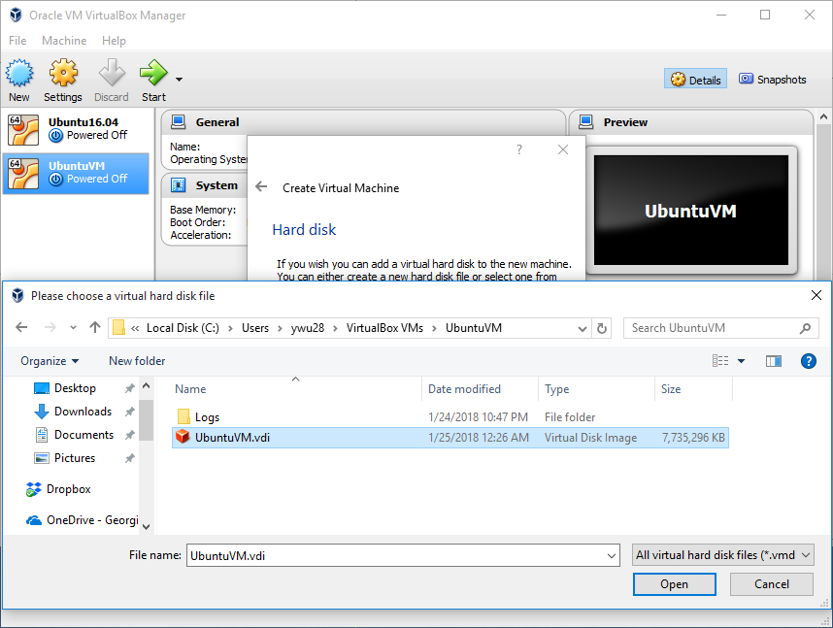
Step 4
Go to the directory of “VirtualVM”
You can put it in C:/Users/YourName/VirtualBoxVMs/UbuntuVM/
Choose “UbuntuVM.vdi”
Click “Next”

Slide 7
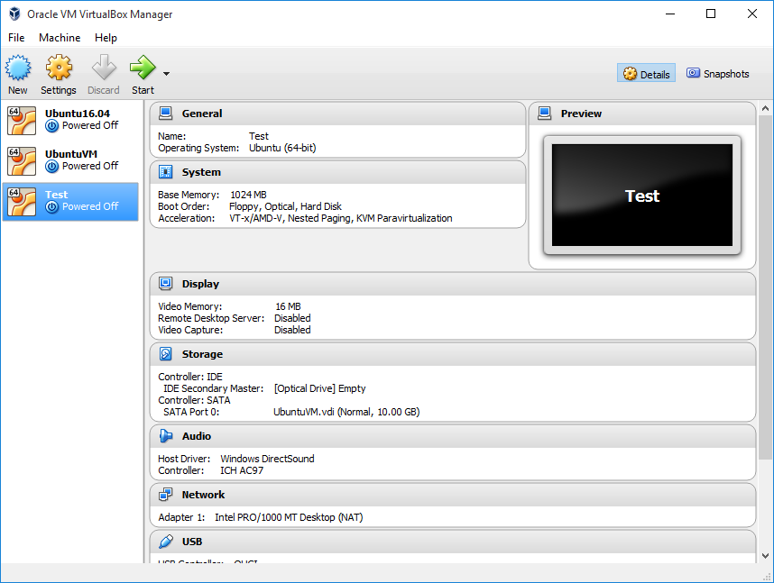
Step 5
The new virtual machine has been created
Click “Test”
Click “Start”

Slide 8
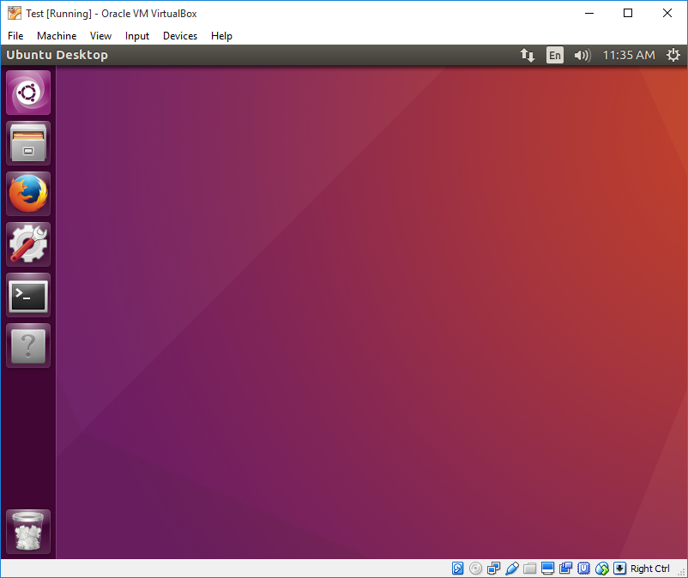
Step 5
Now you see the GUI of Ubuntu OS
Java, Hadoop, and HDFS have been set up.
Sudo Password: 1234

Slide 9
Start HDFS and Run Hadoop Commands
Whenever you start the virtual machine, open the terminal and type
$ ~/hadoop/sbin/strat-dfs.sh
to start the HDFS.
Then you can run any hadoop commands like
$ hadoop jar WordCount.jar /user/rob/data/peterpan.txt /user/rob/peterpan_output1

